Slide 1
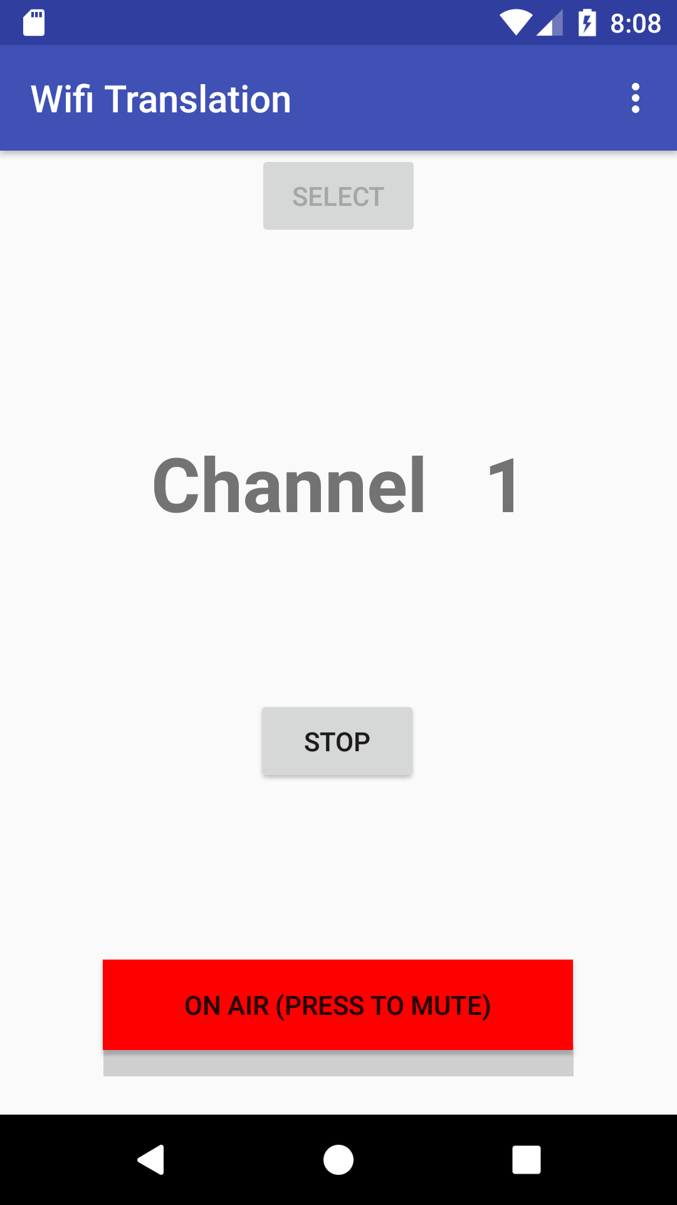
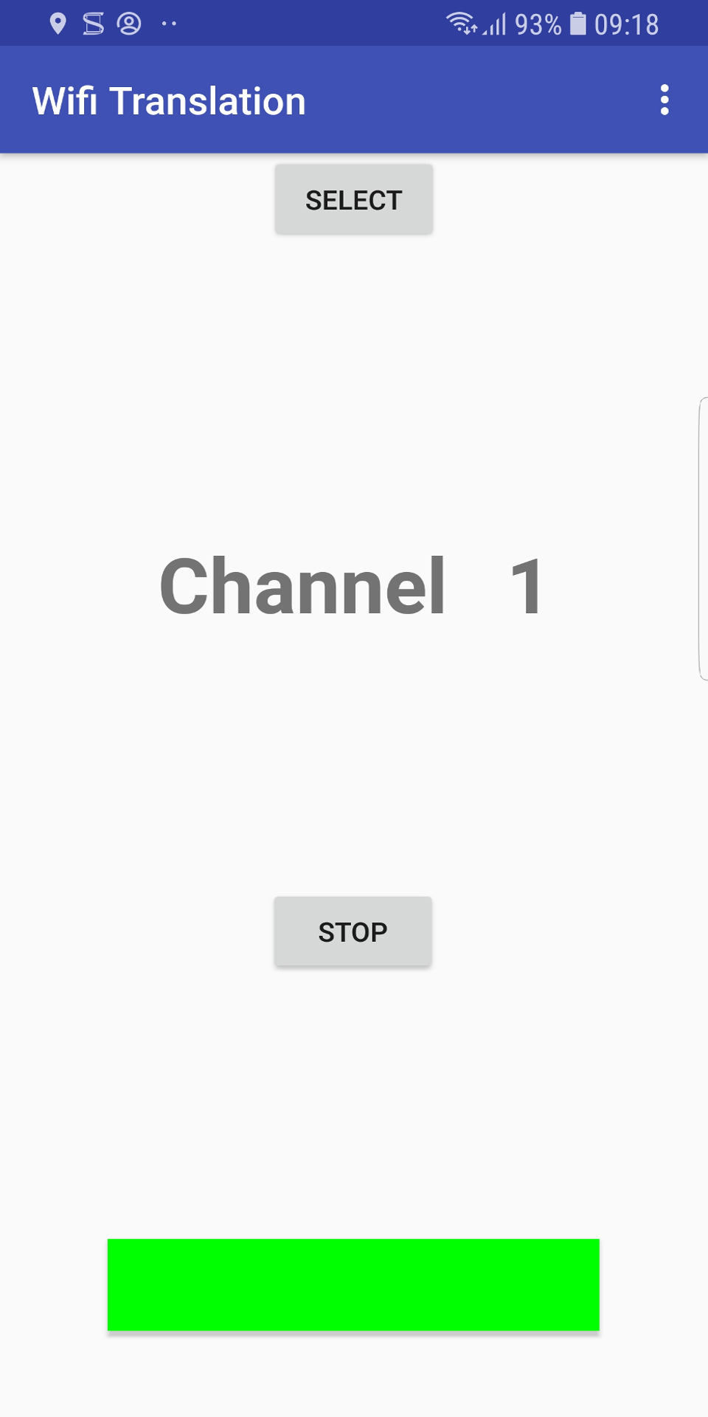
Easy Wi-fi translation
A facility to provide instant translation to smart-phones.
August 2018

Slide 2
What is possible
Easy
  Translation from/to Android phones in minutes
Intermediate
  Translation with the translator in a separate room
Advanced
  Translation to both Android and IOS phones

Slide 3
Easy

Slide 4
Basic setup
First make sure the Android smart phones of the Translator and everyone who needs translation (Listeners) are all connected to the same Wi-Fi.

Slide 5
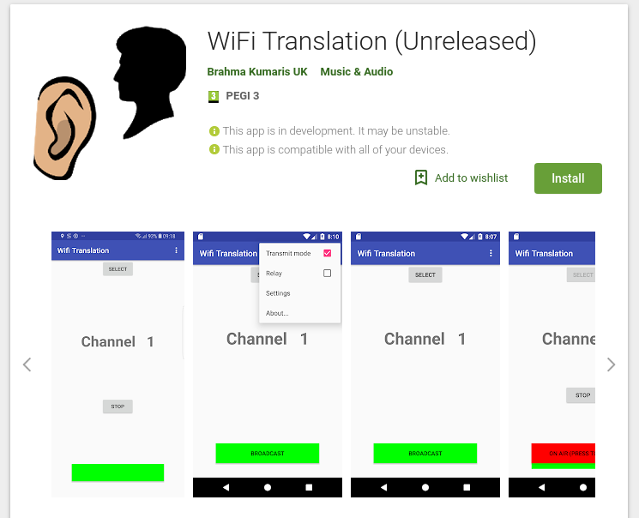
Install the App
Search for the “WiFi Translation” app on Google Play store and install for the Translator and each individual (Listener) who requires translation.

Slide 6
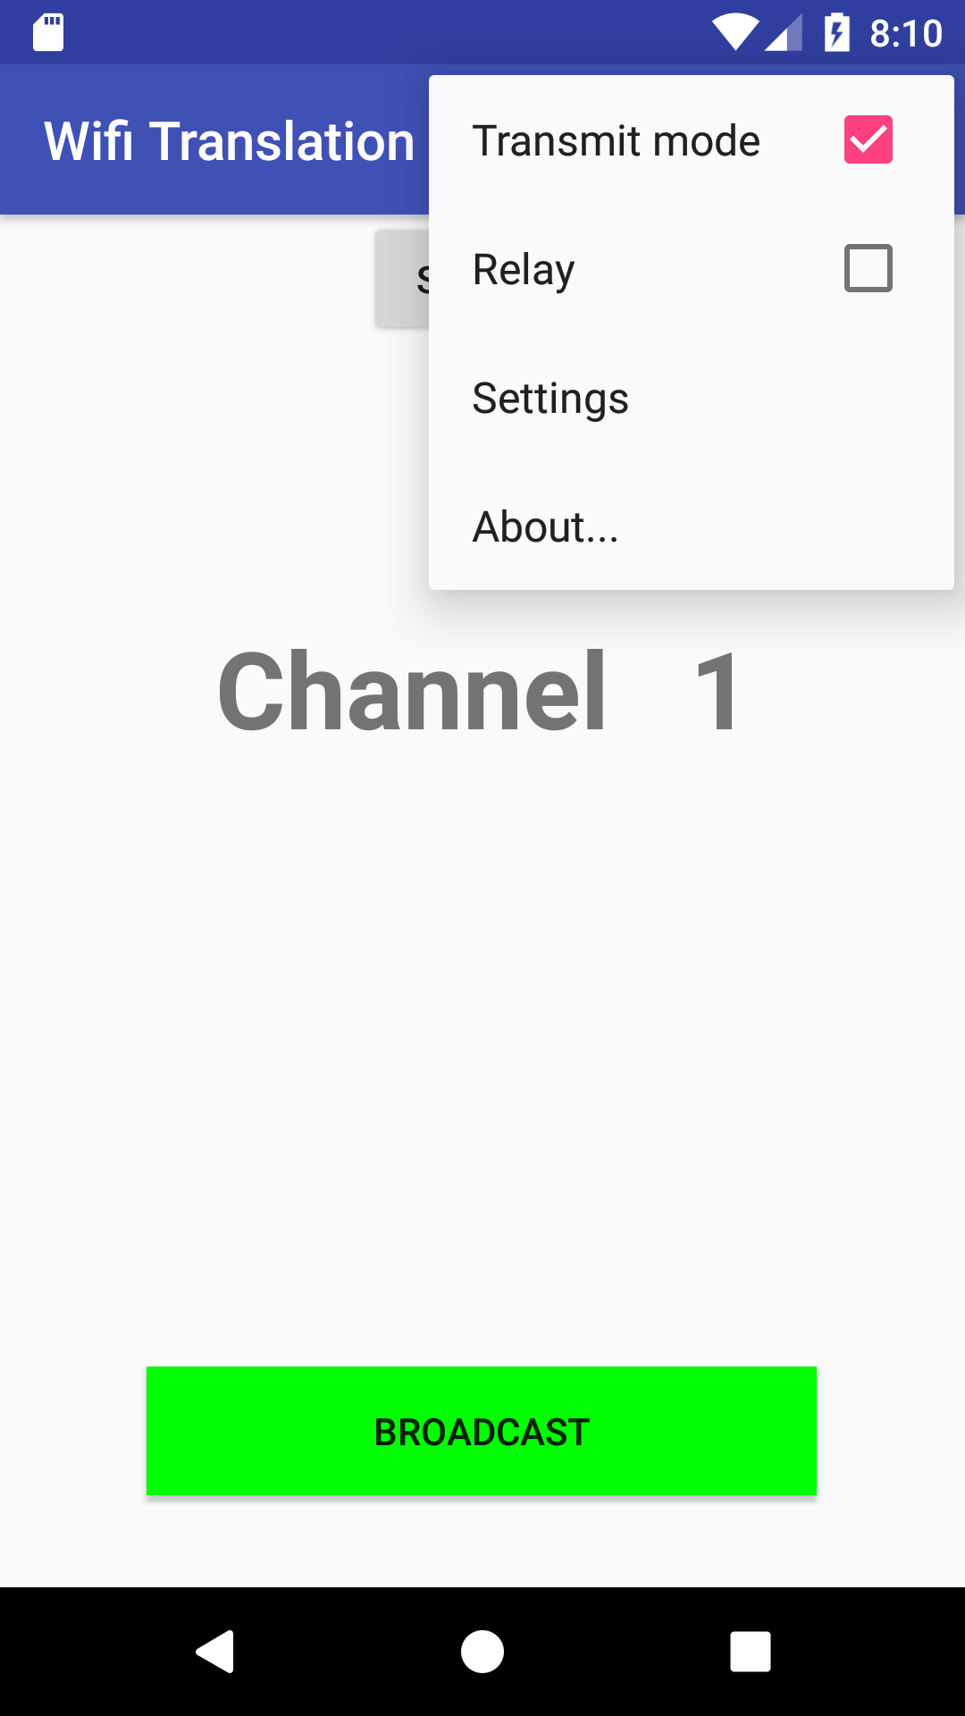
For the Translator
Go to the menu and select “Transmit mode”.
Press the green BROADCAST button to begin the translation.
The button will change to red and indicate that the translation is now “ON AIR”.

Slide 7
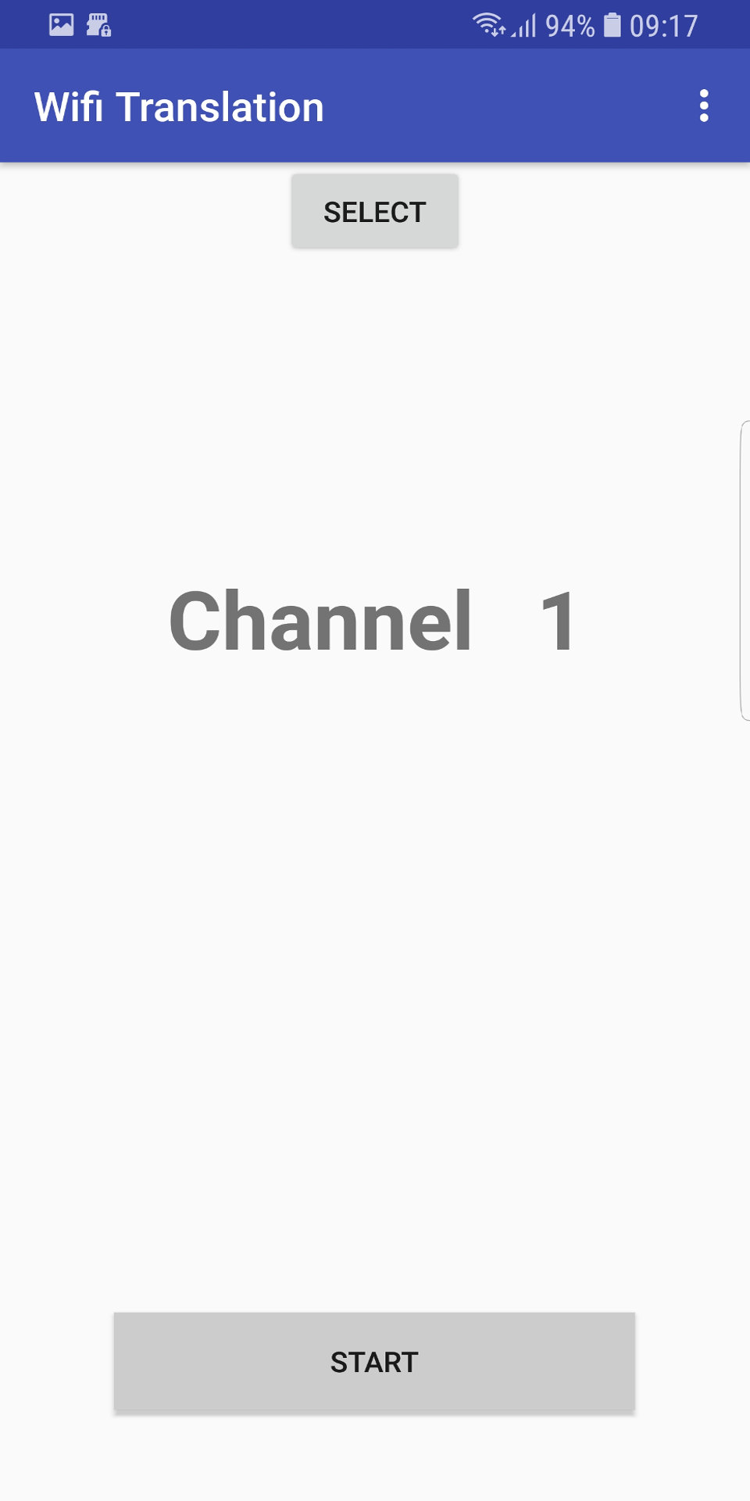
For each Listener
Ensure that headphones are plugged into each phone so that the sound doesn’t come out of the speaker and disturb others.
When the Translator starts translating then each Listener should see a “START” button.
Simply press this button to start listening.
The button should change to green indicating that the translation is being received.

Slide 8
Intermediate

Slide 9
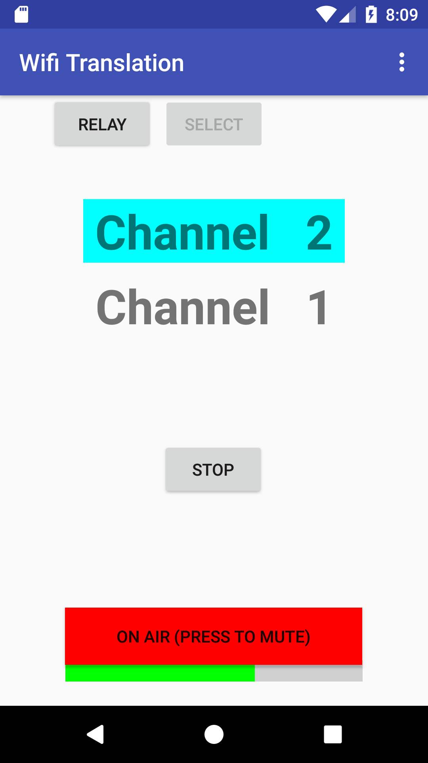


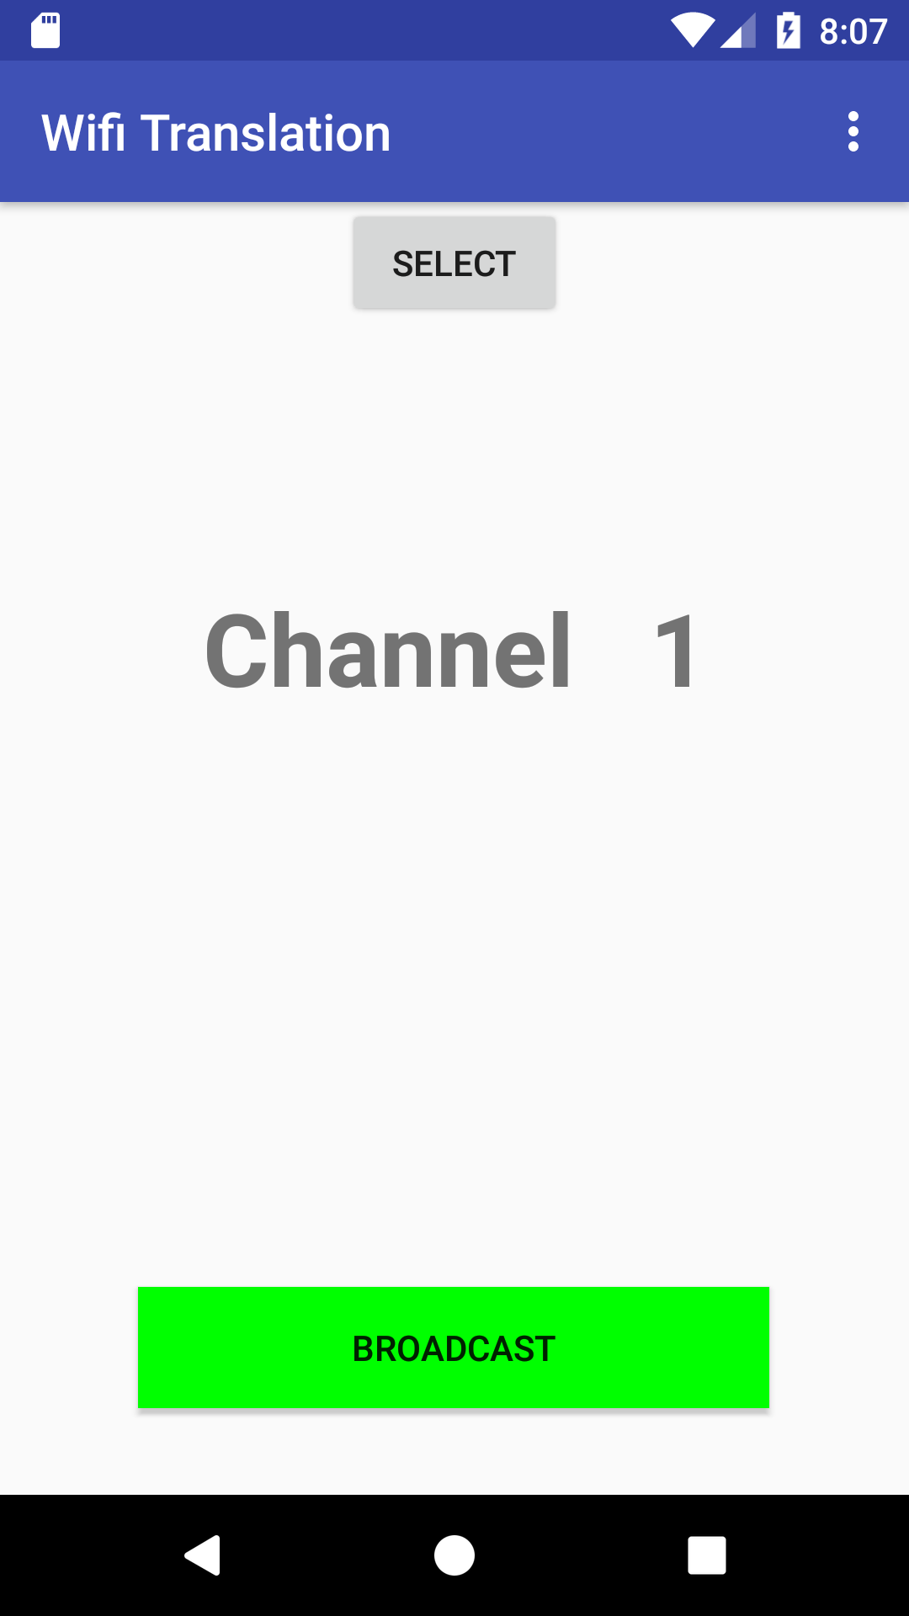

Translator in separate room
Having a translator in the same room can be disturbing to others.
Using the “Relay” function it is possible to send the sound to the Translator in another room who can then Translate back.
2

Slide 10
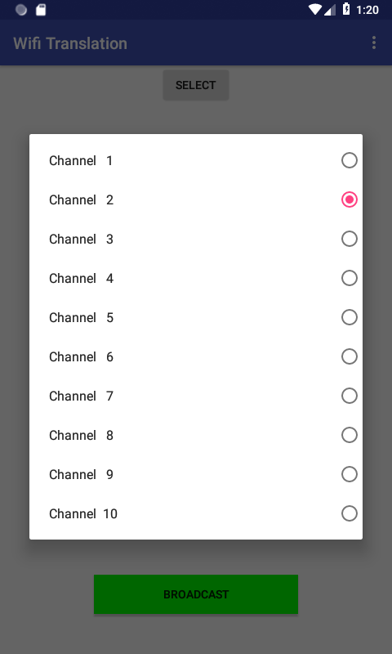
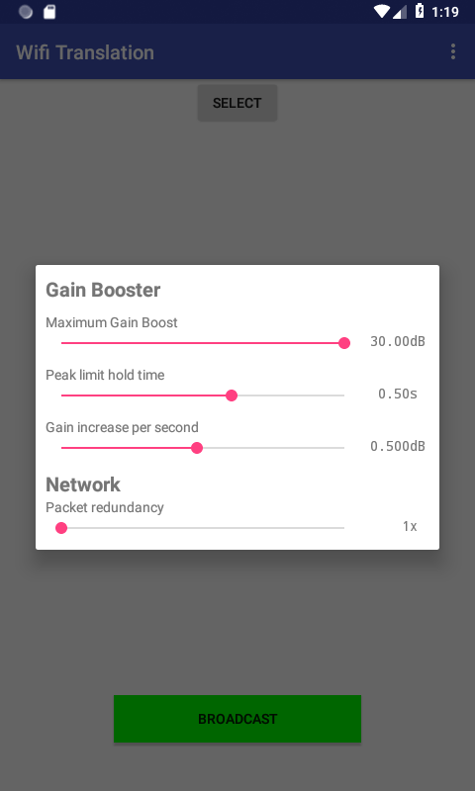
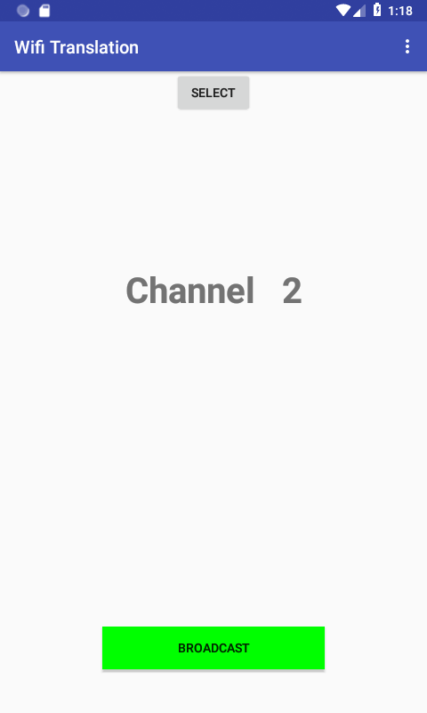
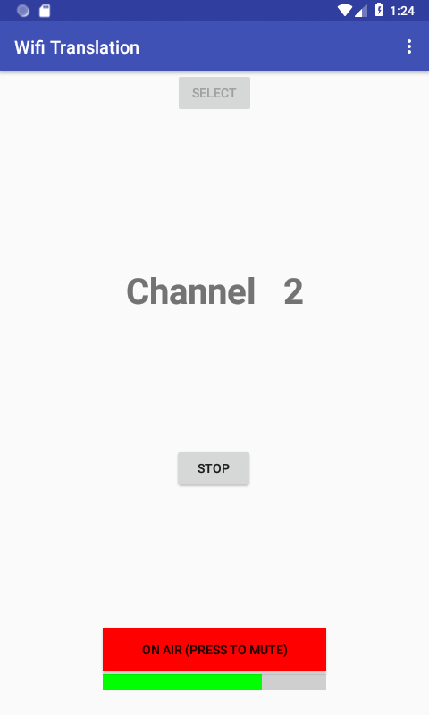
Place a phone near the speaker
Set a phone to “Transmit Mode”
Set to Channel 2 using the Select button
In the top menu, select “Settings”
Increase the Maximum Gain Boost to maximum
Press “BROADCAST”

Slide 11
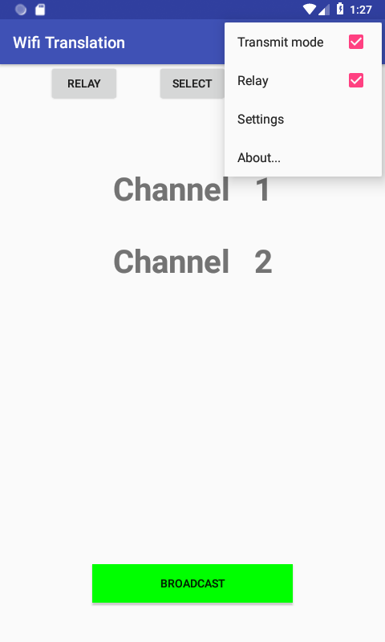
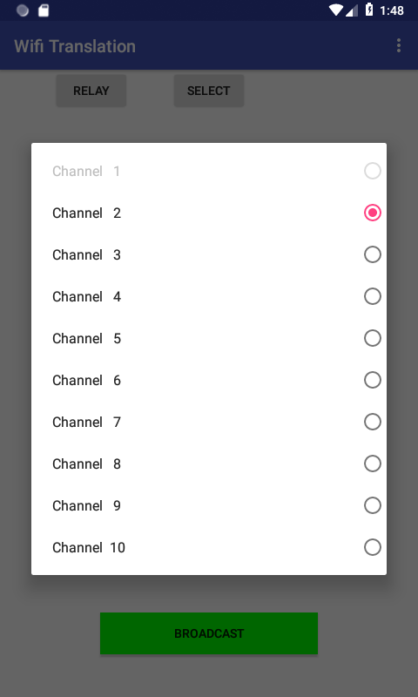
Set up the Relay
On the translator’s phone goto the Settings menu and select “Relay”
A new “Relay” button will appear. Ensure that it is set to Channel 2.

Slide 12
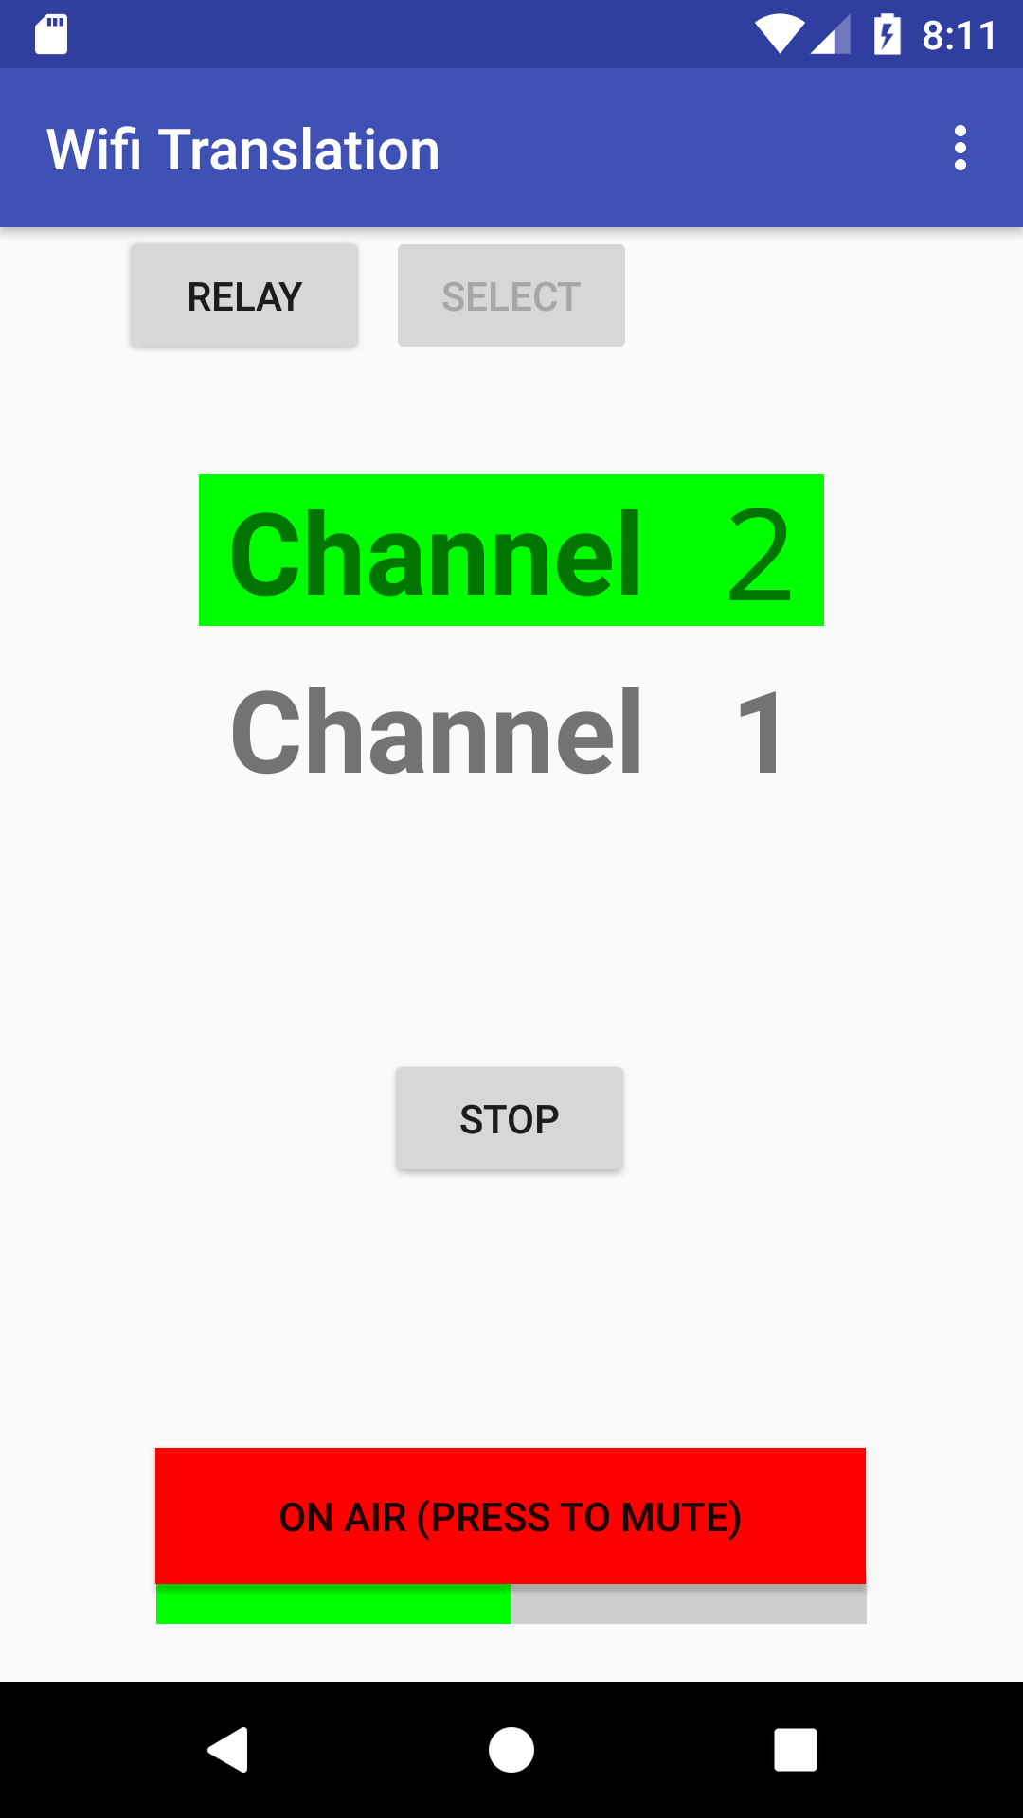
Start translating
Plug in some headphones so that the translator can hear the Speaker while translating
Press the BROADCAST button to start hearing and translating

Slide 13
Advanced

Slide 14
The Wifi Translation Hub
Problem: The App is only available for Android
Solution: A program, the “Wifi Translation Hub”, that runs on a Windows PC provides a web browser player that will work on anything, including IPhones
Using the program, it is no longer required that the Listeners install an app

Slide 15
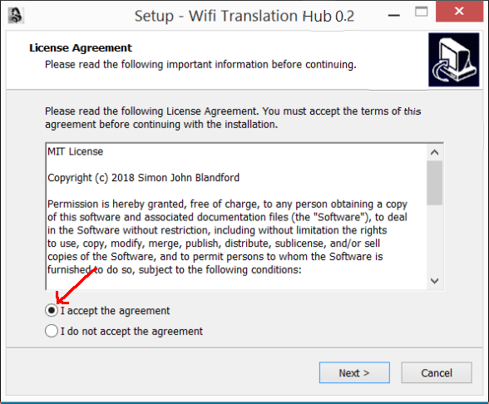
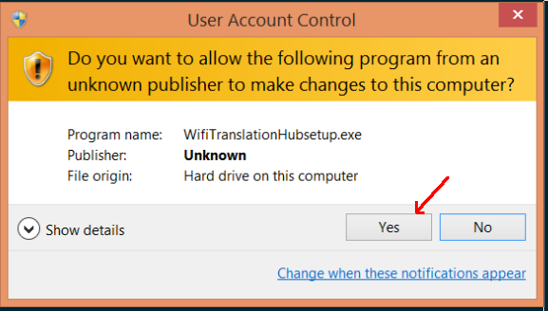
Install the “Hub”
Download and install the Program on a PC running Windows 7 or above:
  https://github.com/sblandford/WifiTranslationHub/raw/Development/Output/WifiTranslationHubsetup.exe
Answer any questions as affirmative

Slide 16
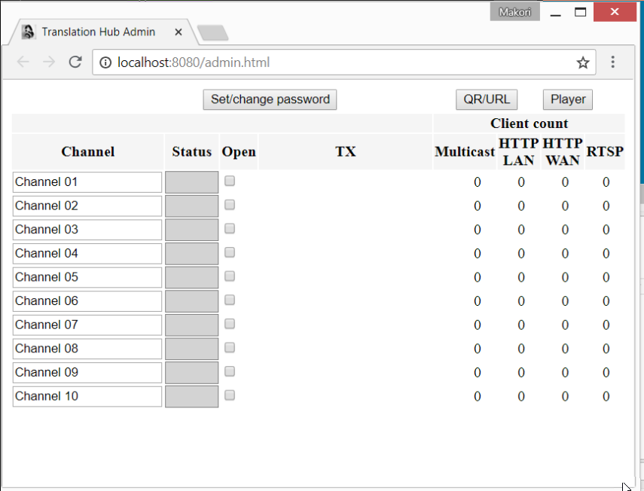
After installation
When the program has installed the web browser should open and show the admin page

Slide 17
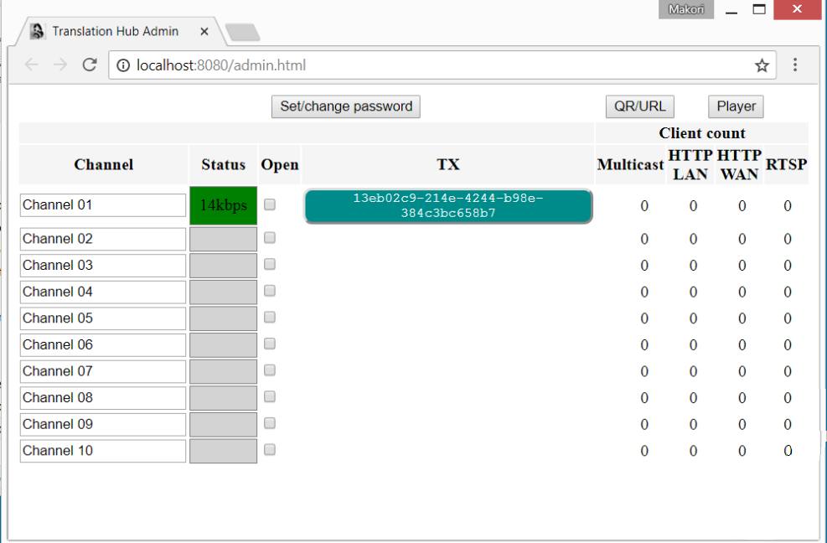
Test reception
Start the Translator’s Android phone transmitting
The Hub web page should show a green status as shown below

Slide 18
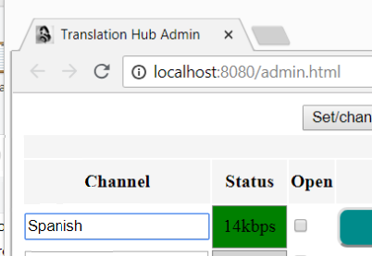
Name the language
Click twice, slowly, on the Channel name to edit it
Change the name
Click outside the text box to finish

Slide 19
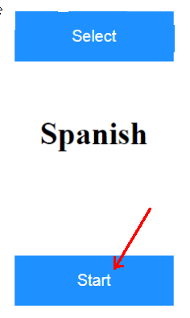
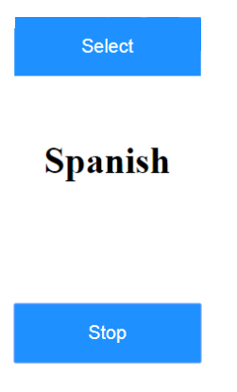
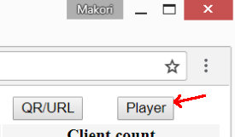
Tune in
To test the translation, click the Player button
Press the Start button
Check the translation is audible from the PC

Slide 20
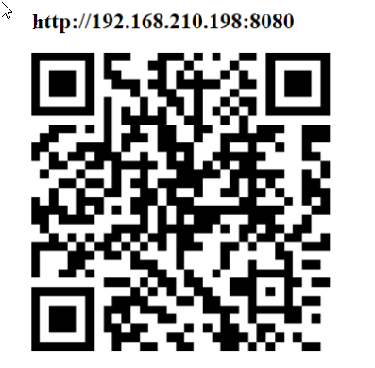
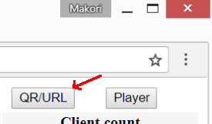
Listen from a Phone
Press the QR/URL button, either from the Admin page or the Player page.
Either scan the QR code with a QR code reader or manually type the URL into a smart phone web browser.
The URL and QR code can be printed

Slide 21
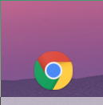
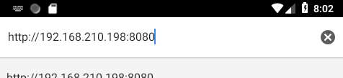
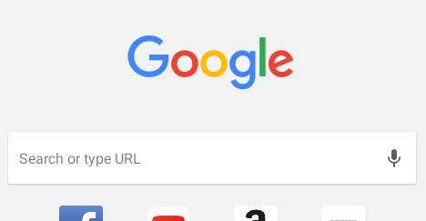
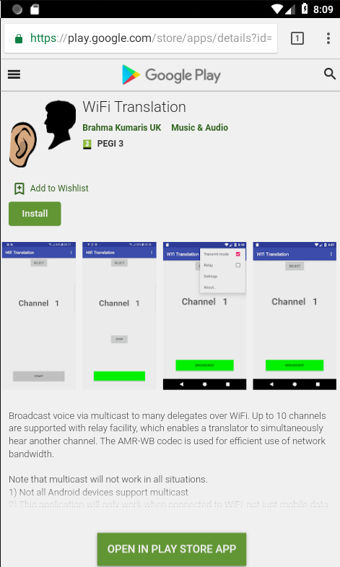
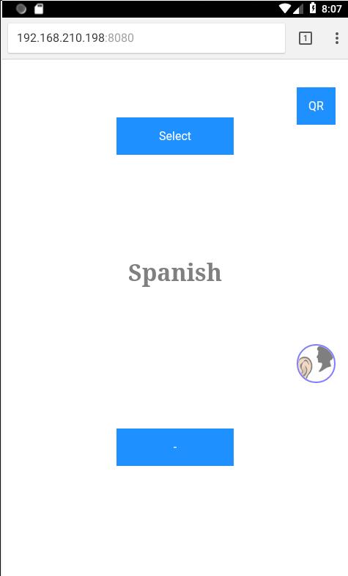
Where to enter the URL on Android
First time: try the App
Second+ time: Web player

Slide 22
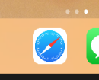
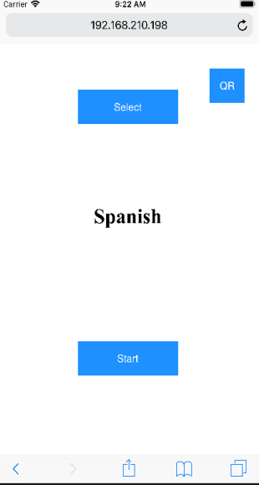

Where to enter URL on IPhone
Alternatively, just open the IPhone camera and point it at the printed QR code

Slide 23
Using the QR code on Android
Unfortunately, scanning QR codes is not built-in to Android, it requires an App
Even worse, most of these apps bombard the user with advertisments
Recomendation: Search Play Store for “QR Code Reader – No Ads” by “Sustainable App Developer”
For most applications, it is probably easier just to type in the URL than to install an additional App

Slide 24
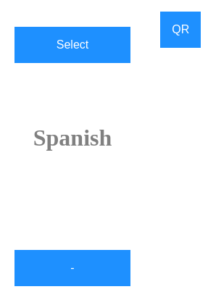
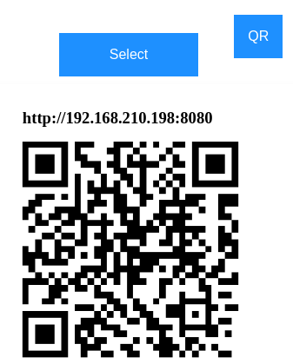
Sharing the URL/QR code
Any phone using the web player can share the URL and QR code with the person sat next to them
Press again
to clear

Slide 25
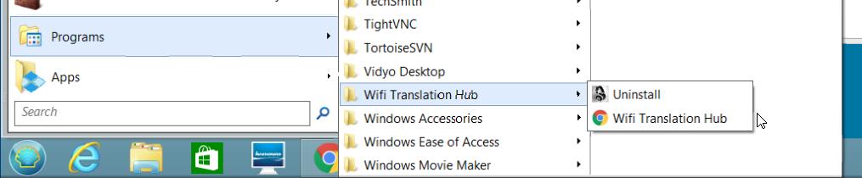
Finding the Admin panel again
The Hub is running in the background whenever the PC is switched on
The admin panel can be found in the “Programs” menu
The uninstaller is also available to completely remove the Hub if required

Slide 26
Notes

Slide 27
Headphones
Nearly everyone has a smart phone but few will have headphones with them
Headphones can be purchased very cheaply and handed out for use
Example headphone source £1.32 each:
  https://cpc.farnell.com/pro-signal/psg03468/headphones-stereo-1-2m-lead/dp/AV18777
Keep headphones in small bags or similar to prevent wires becoming tangled between usage

Slide 28
Phones that don’t work
The Wifi Translation App uses “multicast” to transmit over Wifi
Not every Android phone works with multicast
If the App doesn’t work, then either use another phone or install the Wifi Translation Hub to provide the option of using the web browser player

Slide 29
Bugs and Crashes
The Wifi Translation App and the Hub are still “Beta” software
They may occationally crash or misbehave
Please submit any crash reports on the Android phone and communicate any issues and problems to:
  simon@bkconnect.net
With this feedback the performance and stability can be improved

Slide 30
Other use of Relay mode
In this presentation, Relay has been used to enable a translator to be located in another room
It is also possible to use the Relay mode for one translator to hear another translator e.g. Hindi → English → French

Slide 31
URL/QR code
This will usually stay the same indefintely but can sometimes change due to some Internet routers
  Recomendation: Check the URL still works regularly and before any programme
If and when it changes, re-print it out and let everyone know

